Slide 1


Green Pace
Security Policy Presentation
Developer: Elora Newcomb

Slide 2
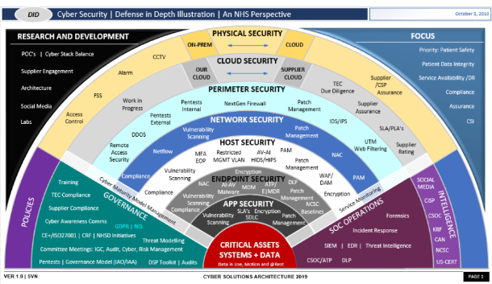
OVERVIEW: DEFENSE IN DEPTH
Defense in Depth (DID) is like a shield that guards every part of an organization.
To create this protective shield, we follow strict rules at every level, from big-picture planning to the nitty-gritty details of code and hardware.
Think of it as a set of protective layers. If one layer is compromised, other layers step in to keep us safe.
In the world of cybersecurity, it's as if the gold standard for staying secure and excellent.

Slide 3
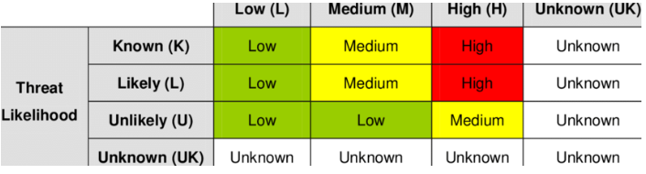
THREATS MATRIX
The Threat Matrix is a visual tool that helps us understand the potential risks in a graphical format.
We measure the potential impact of a threat by assessing its severity.
We use likelihood as a statistical measure to gauge how probable an event is.
Threats with high likelihood and severity can be particularly damaging, making adherence to coding standards critical.
Other factors to consider include the cost and the level of effort required to implement these coding standards.

Slide 4
TEN CORE SECURITY PRINCIPLES
Validate Input Data.
Heed Compiler Warnings.
Architect and Design for Security Policies.
Keep It Simple.
If not explicitly allowed, the default is to reject (Default Deny).
Adhere to the Principle of Least Privilege.
Sanitize Data Sent to Other Systems.
Practice Defense in Depth .
Use Effective Quality Assurance Techniques.
Adopt a Secure Coding Standard.

Slide 5
CODING STANDARDS
Null-Terminated Strings: Ensure null-termination for C-style strings.
Null References and Dangling Pointers: Prevent null references and dangling pointers.
Goto Statements and Ad-Hoc Branching: Avoid using goto statements and ad-hoc branching.
Library Code Utilization: Rely on established library code instead of reinventing.
Unsigned Integer Overflow: Validate unsigned integers to avoid overflow.
Float-to-Integer Casting: Optimize float/double to integer casting.
Floating-Point Counters: Avoid using float as a counter variable.
Garbage Collection: Consider Boehm or other garbage-collected solutions for complex projects.
Exception Handling: Use exceptions for error handling, preventing hard stops.
Virtual Functions in Constructors/Destructors: Avoid calling virtual functions in constructors or destructors.

Slide 6
ENCRYPTION POLICIES
Encryption secures data through cryptographic techniques.
Encryption at Rest: Protects stored data from unauthorized access.
Encrytion In Flight: Safeguards data during transmission.
Encryption In Use: Secures data actively processed by applications.
Encrypting data ensures confidentiality and integrity.

Slide 7
TRIPLE-A POLICIES
Through its three distinct levels, it ensures that network resources be used safely:
Authentication: Verify users' or devices' identities for authorized access.
Authorization: Control user privileges and restrict unauthorized actions.
Accounting: Log all system actions for transparency and accountability.

Slide 8
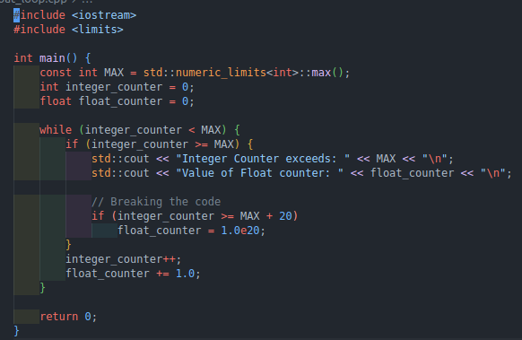
Flat Loops
The program's focus: Assessing precision errors in floating-point numbers.
Controversies surround their use due to these inherent issues.
Compiler doesn't flag precision errors, highlighting the need for attention and correction.

Slide 9
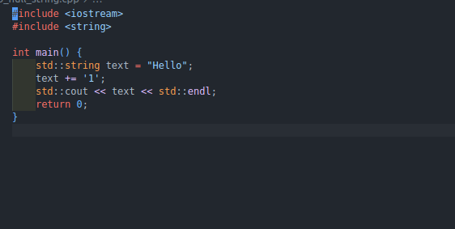
Non Null Terminated Strings
The code output: "Hello1α²⌂"
Something is amiss with our expectations.
The omission of the null terminator prevented "cout" from reaching the end of the string.
Forgetting null termination can lead to unexpected consequences, but this issue is easily preventable.

Slide 10
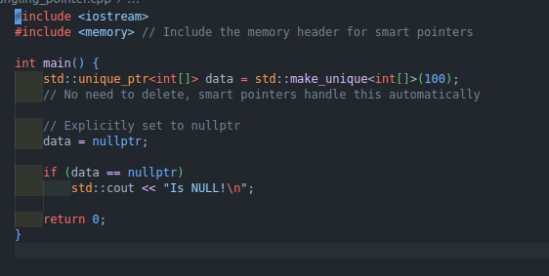
No dangling pointers
It is recommended that the pointers be set to NULL following deletion.

Slide 11

AUTOMATION SUMMARY

Slide 12
TOOLS
DevSecOps: Collaboration between software engineers and IT security/operations professionals.
Objective: Embed security into the software development process.
Key Components: Setting security standards from the outset and continuous enhancement.
Achieving Security: A blend of organizational culture, automation, and design.
Tools for Early Detection: Use of compilers and debuggers to identify potential weaknesses during development.
Continuous Testing: Incorporate testing both during and after development to uncover and address bugs and security flaws.

Slide 13
RISKS AND BENEFITS
Balancing Risk: A system can be nearly risk-free up to a certain point, but exceeding that point doesn't yield a favorable benefit-to-cost ratio.
Inherent Risks: Risks are inherent in all systems and software, but the right approach can mitigate them.
Prevention Over Treatment: Early risk analysis and elimination are crucial, especially for online systems like websites.
Ongoing Vigilance: Stringent inspections in the operational phase are essential for long-term safety.
Holistic Defense: To ensure system safety, integrate DevSecOps with a defense-in-depth strategy.

Slide 14
RECOMMENDATIONS
Challenges: Conveying security principles to developers can be challenging.
Essential Element: Security is not an additional task but a vital component of the development process.
Effective Strategies: Simple yet effective daily security practices can outshine occasional expert analysis.
Education and Training: Invest in developer training for enhanced security awareness.
Shift-Left Approach: Integrate security early to prevent issues.
Continuous Improvement: Cultivate a culture of ongoing security enhancement.

Slide 15
CONCLUSIONS
By integrating security into the development cycle, we emphasize the importance of proactive measures.
Adhering to coding standards significantly bolsters software safety.
Implementing a defense-in-depth strategy can transform a company's development culture, leading to more secure software.
Our zero-trust approach ensures ultimate security by encrypting data in all communications.
The triple-A architecture is a valuable asset for detecting and mitigating data breaches.

Slide 16
REFERENCES
C++ coding standards: 101 Rules, guidelines, and best practices. µOS++ IIIe. (2018, March 26). Retrieved December 10, 2022, from https://micro-os-plus.github.io/develop/sutter-101/
Kirsh, A. (2022, August 16). Top 10 secure C++ coding practices. Incredibuild. Retrieved December 10, 2022, from https://www.incredibuild.com/blog/top-10-secure-c-coding-practices

